Slide 1
MICROPROCESSOR BASED SYSTEM DESIGN
Lecture # 05 - 06
BY
PROF. DR. B. S. CHOWDHRY

Slide 2

Latest innovations
Microprocessor Based I Pill: Programmable drug Releaser
In the form of an 11 x 26 mm capsule, the iPill incorporates a microprocessor, battery, pH sensor, temperature sensor, RF wireless transceiver, fluid pump and drug reservoir. It communicates via its wireless transceiver to a control unit outside the body.
Localized drug delivery is performed by the iPill’s internal pump under the control of the microprocessor, allowing accurate control of the drug delivery profile. Examples of possible delivery profiles include a burst, progressive release or a multi-location dosing.
http://www.research.philips.com/newscenter/backgrounders/081111-ipill.html (Last Accessed 30 May 2011)

Slide 3
Addressing Modes of the 6800 Microprocessor
Addressing Modes of 6800
Inherent (Implied)
Direct /Extended
Immediate
Indexed
Relative

Slide 4
Inherent Addressing Mode
Instructions, which do not have any operand OR their Operand is predefined in the OPCODE (Usually Accumulator). These instructions take 1 byte in the Memory. For Example:
-NOP (No Operation)
-CLR A (Clear Accumulator A)
- SUB B (B = B-1)
-CLC (Clear Carry Flag)
-PSH A (Push A into Stack)

Slide 5
Immediate Addressing Mode
In this mode, Operand itself is specified in the program memory location, next to the OPCODE
These instructions occupy two bytes of the program memory.
-Byte 1: OPCODE
-Byte 2: Operand

Slide 6
Direct Addressing Mode
It is special case of Extended Addressing Mode.
In the Direct Addressing Mode, Only LSB of Address is specified. The MSB of the address is assumed as ZERO. These take only Two bytes in the memory.
Hence only ZERO PAGE of the memory address space can be accessed.

Slide 7
Extended Addressing Mode
In Extended Addressing Mode, Address of the Operand is specified in the program memory locations, next to the OPCODE. These Instructions take three bytes in the memory.
-Byte 1: OPCODE
-Byte 2: MSB of Operand’s Address
-Byte 3: LSB of Operand’s Address

Slide 8
Indexed Addressing Mode
These Instructions specify operands address with the help of Index Registers.
The Index Register provided Base Address, which is added with an offset to determine the operand’s address.
These Instructions take two bytes in program memory:
-BYTE 1: OPCODE
-BYTE 2: Offset

Slide 9
Relative Addressing Mode
It is used only with branching instructions. The microprocessor jumps to a location relative to its present location.
These instructions occupy two bytes of program memory:
Byte 1: OPCODE
Byte 2: Offset
The offset is added into the contents of Program Counter. If offset is positive, the jump is Forward; otherwise, the jump is Backwards.

Slide 10
Software The µComputer Program
The native language of µComputer or µProcessor is Machine language.
Single instruction can take 1 to 6 bytes of code.
But it is almost impossible to write programs directly in machine language
(1s & 0s).
For this reason, programs are normally written in Assembly language or some high level language like BASIC, PASCAL or C.
The Assembly language is a form somewhat in between a low-level language (machine code) and a high level language.

Slide 11
Software_ Assembly Language
The programs called Assembler are used to write and convert an Assembly language program into machine code.
For Example:
-MASM or Microsoft Assembler
-TASM Turbo Assembler

Slide 12
Software Assembly Language
The Assembly Language Program is written in 4 fields:
Label
Mnemonic
Operand
Comment
Each instruction of the Microprocessor is given a nomenclature, called Mnemonic.

Slide 13
Example Assembly Language
Label Mnemonic Operand Comment
LDA A # 00h A = 0
LDA B # FFh B = 255
Back ADD B A = A+B
DCR B B = B-1
NOP Wait 1 cycle
BNE Back Go back if B≠0
SWI

Slide 14
Software _High Level Language
The programs called compilers & interpreters convert a program written in high level language into machine language. The aforementioned program can be written in a high level language like BASIC.
A = 0
For B = 255 to 0
A = A+B
Next B

Slide 15
Why use Assembly Language?
The programs written in High Level Language, when converted into Machine Code by the compiler, yield many unnecessary instructions. The program written directly in the assembly language is usually shorter & faster than the one converted from a high level language by the compiler.
In Real Time applications, the program routine need to quick, and must respond before the occurrence of next input. The examples include Program to Access Floppy Drive, Initialize Ports.

Slide 16
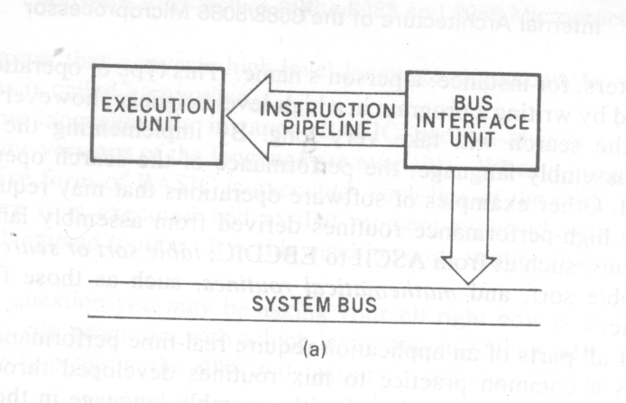
Software Architecture of 8086 µProcessor

Slide 17
Two Main Parts of 8086 µProcessor
The Microprocessor is divided into two main parts:
The Bus Interface Unit
The Execution Unit
They are connected through a pipeline

Slide 18
Jobs of Bus Interface Unit
It is interface to the outside world of µProcessor.
    It performs BUS operations such as:
    Instruction Fetching
    Reading Operands from Memory
    Writing Operands to Memory
    Inputting or outputting data to I/O peripherals.
    Its jobs also include instruction queuing.

Slide 19
Inside Bus Interface Unit
The BIU contains
  Segment Registers
  Instruction Pointer
  Address Generation Adder
  Bus Control Logic
  First in First out (FIFO) stack for instruction queue.

Slide 20
Jobs of Execution Unit
Its jobs include:
  Fetching instructions
  Fetching operands from general purpose registers
  Executing instructions
  Generates operands addresses & passed them to the BIU.

Slide 21
Software Model of 8086 µProcessor
The term software model or programming model refers to the sets microprocessor registers which are accessible to the programmer.

Slide 22
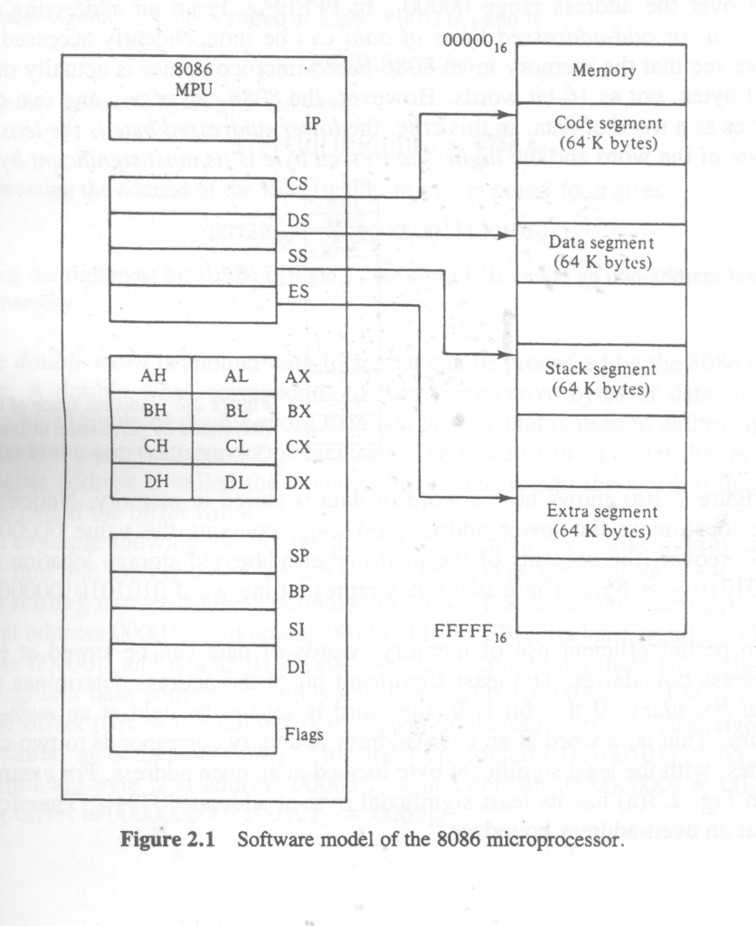

Slide 23
Registers Inside µProcessor 8086
The 8086 has following 16-bt registers, which are used to carry base address:
Code segment (CS) Register
Data segment (DS) Register
Stack segment (SS) Register
Extra segment (ES) Register

Slide 24
Following 16-bit registers are general-purpose registers of 8086
AX (Separable 8-bit AH & AL)
BX (Separable 8-bit BH & BL)
CX (Separable 8-bit CH & CL)
DX (Separable 8-bit DH & DL)
SR (Status Register)

Slide 25
Following are the 16-bit registers, which carry offset address:
Instruction Pointer
SP (Stack Pointer)
BP (Base Pointer)
SI (Source Index)
DI (Destination Index)

Slide 26
Address Space of 8086
The 8086 has 20 address lines
It can access 2²⁰ 1 Million (1 Mega Byte) memory locations.
Its addresses range from 00000h to FFFFFh
Some parts of the address space are reserved. Some are dedicated and others ore open for general use.

Slide 27
Reserved & Dedicated Parts of Address Space.
Dedicated & Reserved Area-1
These are 128 bytes
These are used for storage of pointers to interrupts.
Each interrupt pointer occupies 4 bytes
2 for Base Address
2 for Offset
In this way (128/4) 32 pointers can be stored in these locations.

Slide 28
Dedicated Area 2
This area ranges from FFFF0h to FFFFBh.
It is dedicated for some special function for example, FFFF0h is the reset vector of 8086 Microprocessor.
This is the location, where microprocessor begins execution after RESET.
Reserved Area 2
These are four locations from address FFFFCh through FFFFF.
These are reserved for use with further products.
It should not be used.

Slide 29
